Slide 1
Annuity Purchaser Study
By Simon Liu Mar, 2018
Notes:
Mar, 2018 By Simon Liu

Slide 2
Background: A financial institution wants to predict who will purchase variable annuity product.
Applying predictive modelling on customer data: logistic regression and decision tree.
  Feature selection: stepwise selection using AIC criteria.
  Data set split: training (70%) and holdout (30%).
  Decision Tree: grow and prune the tree.
  Model evaluation: AUC, ROC on testing data.
By Simon Liu
Notes:
Mar, 2018 By Simon Liu

Slide 3
Variable Description:
Ins: purchased variable annuity (1=yes, 0=no).
DDA: checking account (1=yes, 0=no).
DDABal: checking account balance.
Depamt: amounts deposited.
CashBk: number of times customer received cashback.
Checks: number of checks.
Phone: number of times customers use telephone banking.
Sav: saving account (1=yes, 0=no).
Savbal: saving account balance.
IRA: has retirement account (1=yes, 0=no).
Mtg: has mortgage account (1=yes, 0=no).
By Simon Liu
Notes:
Mar, 2018 By Simon Liu

Slide 4
Approach and tools: using R glm().
R is used to build model, evaluate model and plot charts.
  Libraries: MASS, tree, stats, ROCR, caret.
  Data cleansing: imputation of missing values, remove outliers.
  Split data to training (70%) and holdout (30%).
  Stepwise regression: select model has lowest AIC.
  Var selected: dda, ddabal, depamt, cashbk, checks,
  phone, sav, savbal, ira, mtg.
  Model: logi_all <- glm(ins~dda+ddabal+depamt+cashbk+…)
  Prune tree: pruned_model <- prune.tree(tree_model,best=5)
By Simon Liu
Notes:
Mar, 2018 By Simon Liu

Slide 5

Result discussion: logistic regression
Stepwise logistic regression
  Check overall significance by chi-square test:
  1- pchisq(n1-n2, df1-df2)
  This “0” indicates the overall model is significant.
By Simon Liu
Notes:
Mar, 2018 By Simon Liu

Slide 6
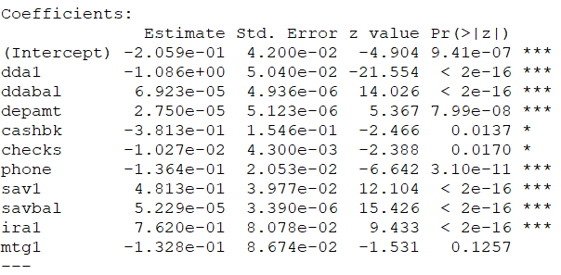
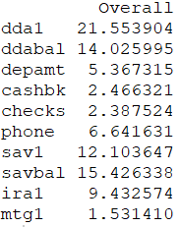
Result discussion: logistic regression (continued)
Stepwise logistic regression
  Promote to people have saving account or IRA account.
  Having a checking account, or frequent user of phone banking or cash back have negative impact on purchasing. (lower odds)
  Table at right-hand is standardized coefficients. Key factors are:
  checking acct (-), saving acct balance (+), checking acct balance (+),
  saving acct balance (+), IRA acct (+).
By Simon Liu
Notes:
Mar, 2018 By Simon Liu

Slide 7
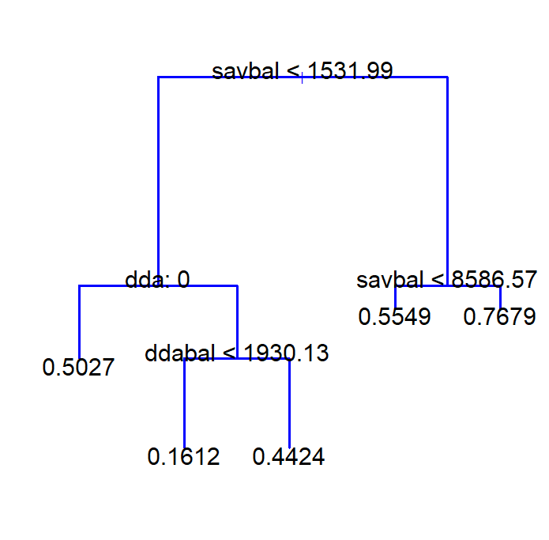
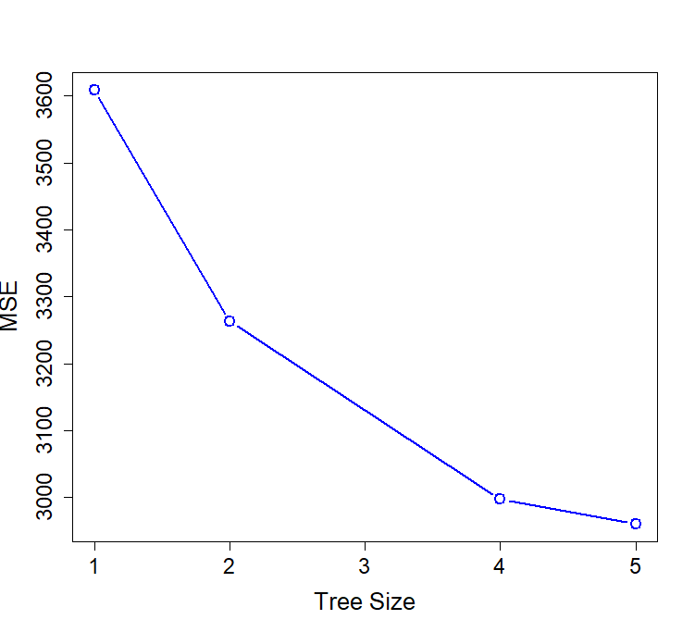
Result discussion: decision tree
Decision tree (after pruning)
  Most important factor is saving
  account balances.
  The more savings deposited,
  the more likely you will
  purchase annuity product.
By Simon Liu
Notes:
Mar, 2018 By Simon Liu

Slide 8
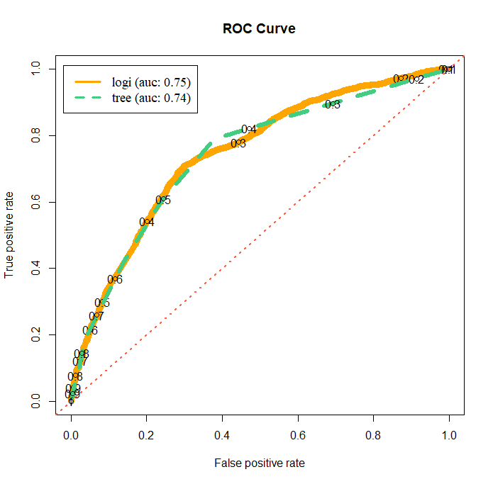
Model evaluation: AUC and ROC
ROC curve and AUC
  Logistic regression and decision
  tree have similar ROC curve.
  when cutoff is high (>0.8), two curves
  almost coincide.
  Decision tree is easier to
  Interpret than logistic regression.
  AUC score is very close for both
  methods.
By Simon Liu
Notes:
Mar, 2018 By Simon Liu

